Slide 1
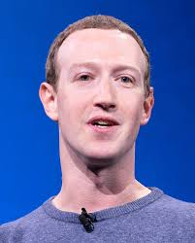
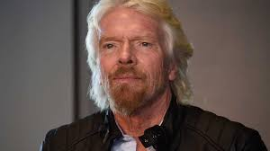
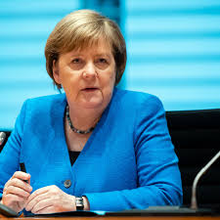
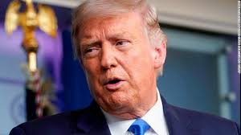
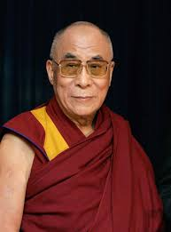
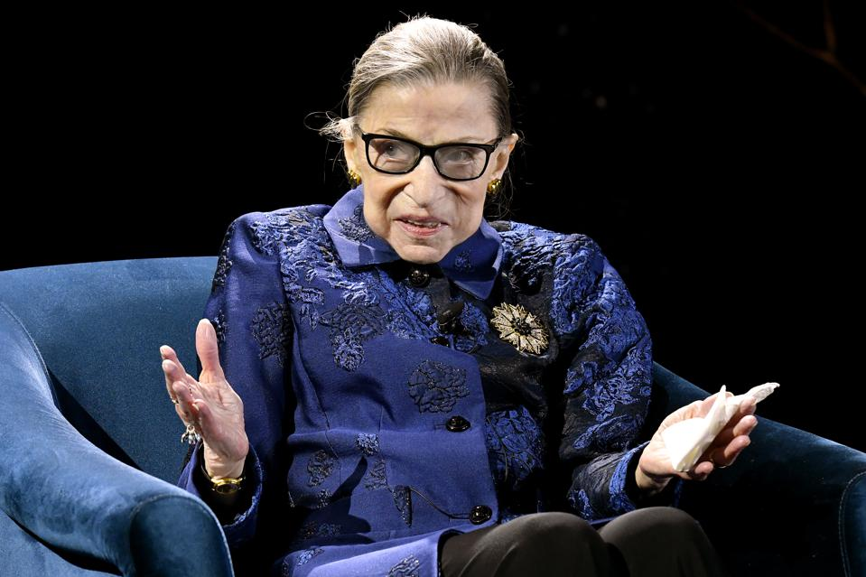
Let’ Talk about
leadership
Notes:
Ruth Bader Ginsburg

Slide 2
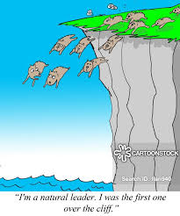
Leading by example What does this mean?

Slide 3

Great Man Theory
“Leader’s are
born with the
right stuff”
Carlyle, 1847)

Slide 4
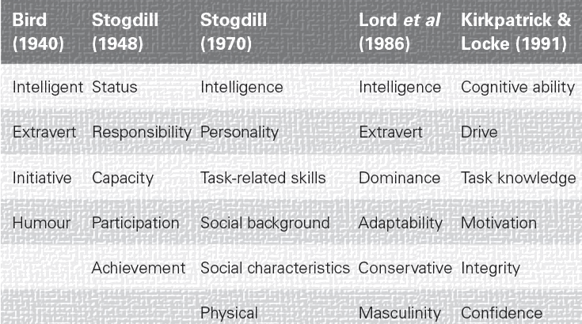
Trait theory
Lord et al (1986)

Slide 5
Behavioural Approach
Authoritarian behaviour
Laissez - faire
Authoritarian behaviour
Democratic behaviour
Lewin, Lippitt & White,1939)

Slide 6
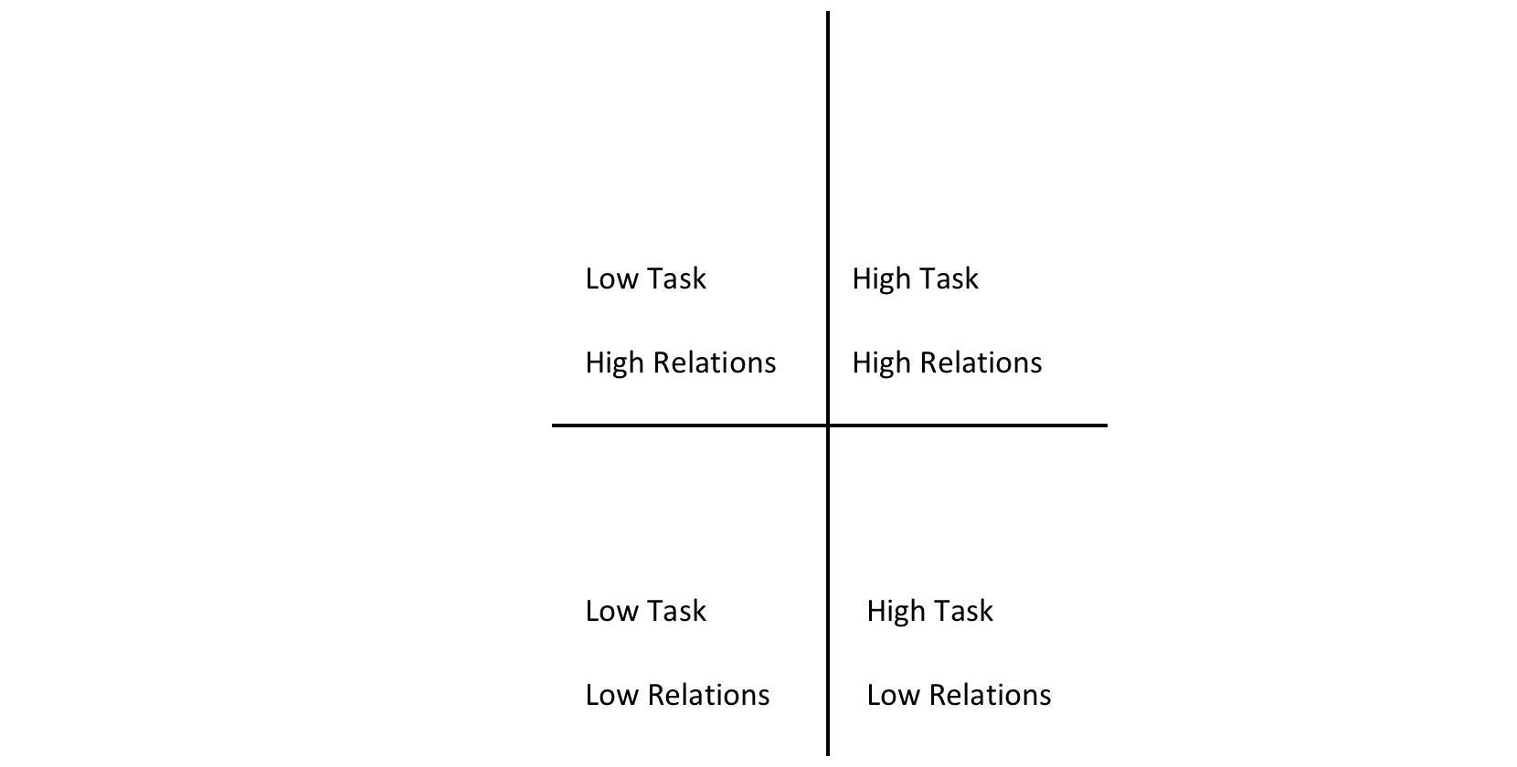
Ohio Studies
LOW Relations Behaviour HIGH
LOW Task Behaviour HIGH
Fleishman (1953,55)

Slide 7
Michigan Studies
LOW Relations Behaviour HIGH
Participative behavior
(Katz, Maccoby & Morse,1950)
LOW Task Behaviour HIGH
Fleishman (1953,55)

Slide 8
Theory X
Theory y
People dislike work
People avoid work
Dislike supervision
Dislike responsibility
Dislike change
People do like work
Source of satisfaction
Want responsibility
Exercise self-direction
Effective leadership can bring out the above qualities in workers
McGregor (1960)

Slide 9
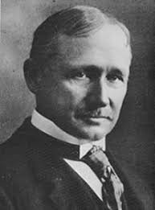
Scientific Management
F
Supports Theory X
Frederic Taylor 1920)

Slide 10
MANAGEMENT
LEADERSHIP
Perform, rational, analytical, intellectual function
Handling complexity (Kotter, 1987)
Insist on harmony- pseudo-agreement
Emphasis is on managing rather than pioneering
Often *top-down) driven by bottom line
Perform inspire vision, values,
confidence and determination
Coping with change (Kotter, 1987)
Challenge status quo (Bennis,1999)
Communicate new vision, direction & strategy
Empowering, bottom up
Collaboration
“Managers do things right, leaders do the right thing” (Bennis, 1997)

Slide 11
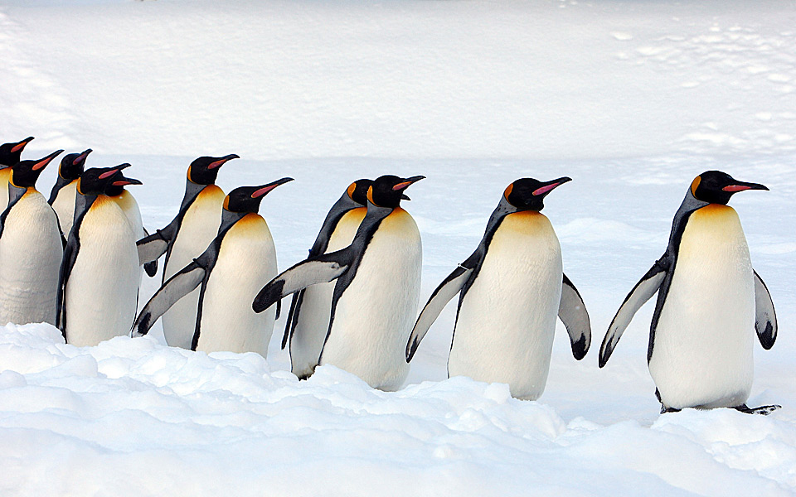
Why do followers follow…?

Slide 12
Leadership Challenges
How do we cultivate Theory Y?

Slide 13
A new way of leading
Adaptive Leadership is a practical leadership framework that helps individuals and organizations adapt and thrive in challenging environments.
Uhl-Bien & Arena (2017)

Slide 14
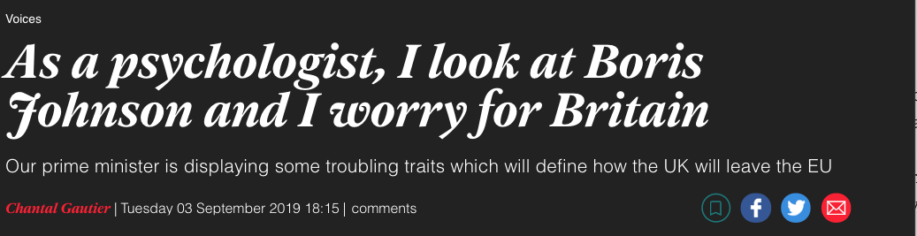
The Independent Article by Chantal Gautier

Slide 15

The Conversation by Chantal Gautier

Slide 16

Do
Have
Leadership
Potential ?
Leader Behavior Description Questionnaires (LDBQ)
Go to BB

